Slide 1


Zachery Gebreab

Slide 2

Outline
Executive Summary
Introduction
Methodology
Results
Conclusion
Appendix

Slide 3
Executive Summary
Summary of all results
Summary of methodologies
Collect data using SpaceX REST API and web scraping techniques
Wrangle data to create success/fail outcome variable
Explore data with data visualization techniques, considering the following factors: payload, launch site, flight number and yearly trend\
Analyze the data with SQL, calculating the following statistics: total payload, payload range for successful launches, and total # of successful and failed outcomes
Explore launch site success rates and proximity to geographical markers
Visualize the launch sites with the most success and successful payload ranges
Build Models to predict landing outcomes using logistic regression, support vector machine (SVM), decision tree and K-nearest neighbor (KNN)
Exploratory Data Analysis:
Launch success has improved over time
KSC LC-39A has the highest success rate among landing sites
Orbits ES-L1, GEO, HEO, and SSO have a 100% success rate
Visualization/Analytics:
Most launch sites are near the equator, and all are close to the coast
Predictive Analytics:
All models performed similarly on the test set. The decision tree model slightly outperformed

Slide 4
Introduction
Background
SpaceX, a thriving company in the space industry is looking to lower the costs of rockets by making them reusable. They developed the Falcon 9, a rocket that has a reusable first stage. This lowers the cost per launch from ~$165 million to ~$62 million! We are trying to understand the factors that lead to a successful landing and reuse of the rocket’s first stage to minimize costs. By examining launch data and using machine learning, we can give SpaceX clear insights on key predictors of a successful launch.
Explore
How factors like payload mass, launch site and more affect the success rate of first stage landing
Rate of successful landings over time
Identify a predictive model for landing success.

Slide 5

Section 1

Slide 6
Methodology
Executive Summary
Data collection methodology:
Describe how data was collected
Perform data wrangling
Describe how data was processed
Perform exploratory data analysis (EDA) using visualization and SQL
Perform interactive visual analytics using Folium and Plotly Dash
Perform predictive analysis using classification models
How to build, tune, evaluate classification models

Slide 7
Data Collection
API: Retrieved rocket launch data from SpaceX API, decoded JSON response, and converted to a DataFrame. Filtered data for Falcon 9 launches, handled missing payload values, and exported to a CSV file.
extract data, created a DataFrame, and exported it to a CSV file
Web Scraping: Collected Falcon 9 launch data from Wikipedia using BeautifulSoup. Parsed HTML tables to

Slide 8
Data Wrangling
Missing Data Handling: Replaced missing values in the Payload Mass column using the mean, ensuring consistent data for analysis.
Filtering: Focused on Falcon 9 launches by filtering the dataset to only include relevant launch records.
Data Structuring: Created new columns and transformed data as needed for analysis and visualization.
Data Cleaning: Removed irrelevant columns and formatted data for uniformity.

Slide 9
EDA with Data Visualization
Exploratory Analysis: Used visualization techniques to understand launch success trends, payload ranges, and orbit patterns
.Charts Used: Scatter plots, bar charts, and line graphs to illustrate launch trends over time and between categories.
Purpose: To identify initial insights and patterns in launch success and failures.

Slide 10
EDA with SQL
SQL Queries: Ran SQL queries to calculate statistics such as launch success rates, total payload per launch site, and orbit-specific trends.
Insights Gathered: Focused on key metrics like payload trends, launch site performance, and the impact of orbit type.
Purpose: To uncover detailed insights into launch data using structured SQL queries.

Slide 11
Build an Interactive Map with Folium
Mapping Launch Sites: Plotted SpaceX launch sites on a Folium map to visualize geographical distribution.
Features Added: Markers and color-coded circles to represent successful and failed landings.
Purpose: To understand the spatial relationships between launch sites and landing outcomes.

Slide 12
Build a Dashboard with Plotly Dash
Interactive Elements: Added dropdowns for launch site selection, sliders for payload range, and interactive pie and scatter charts.
Visuals Created: A dashboard that visualizes launch success rates and payload impacts dynamically.
Purpose: To allow users to interactively explore launch success metrics and relationships between payload and launch outcomes.

Slide 13
Predictive Analysis (Classification)
Model Building: Built and compared models (e.g., logistic regression, decision tree) to predict landing success.
Model Evaluation: Used metrics like accuracy to identify the best-performing model.
Purpose: To determine the likelihood of landing success based on various features, enhancing future launch predictions.

Slide 14
Results
Exploratory data analysis results
Interactive analytics demo in screenshots
Predictive analysis results

Slide 15

Section 2

Slide 16
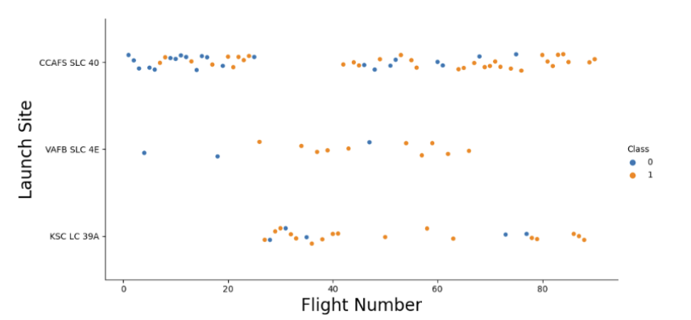
Flight Number vs. Launch Site
Overall, launch success appears to improve as flight numbers increase, reflecting experience gained over time.
0/blue = fail
1/orange = success

Slide 17
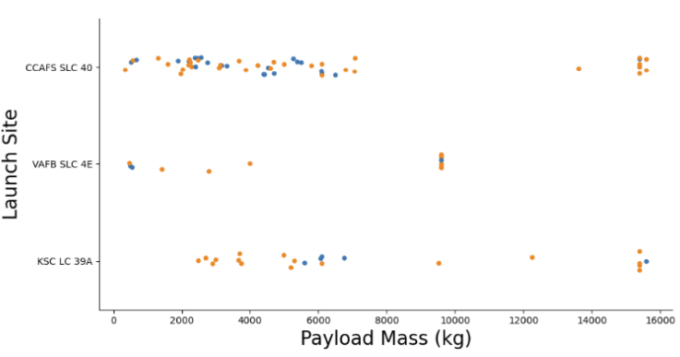
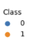
Payload vs. Launch Site
Generally, the bigger the payload, the higher the success rate
Most payloads over 7,000 kg were successful
KSC LC 39A has a 100% success rate for launches less than 5,500 kg

Slide 18
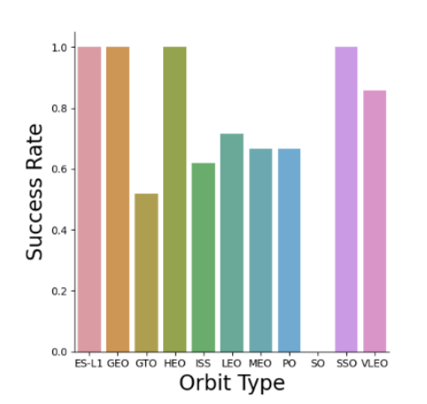
Success Rate vs. Orbit Type
0% Success Rate: SO
50%-70% Success Rate: GTO, ISS, LEO, MEO, PO
~85% Success Rate: VLEO
100% Success Rate: ES-L1, GEO, HEO, SSO

Slide 19
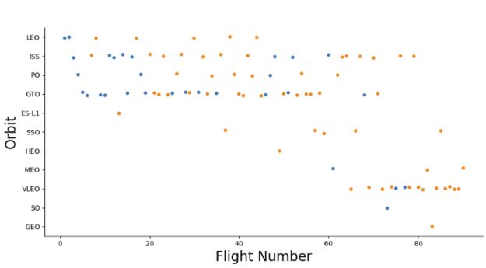

Flight Number vs. Orbit Type
Again, success rate appears to increase as flight number increases.

Slide 20
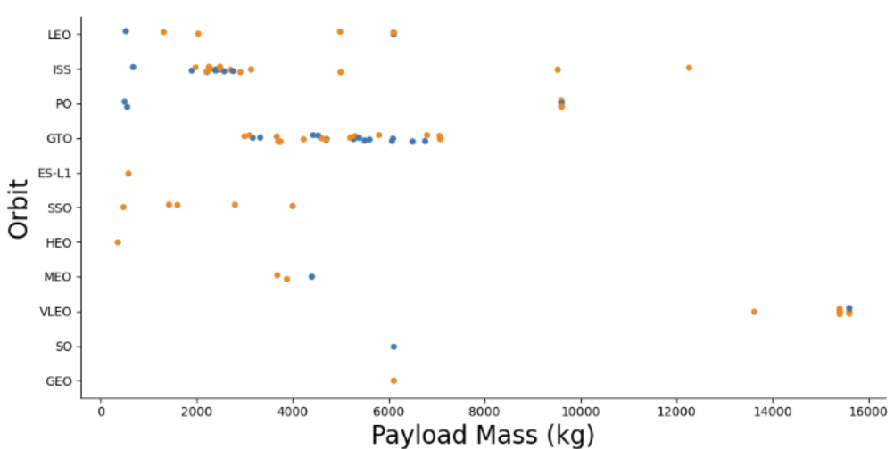
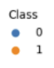
Payload vs. Orbit Type
Heavier payloads are more successful with LEO, ISS, PO, and VLEO
GTO has a mix of failures and successes

Slide 21
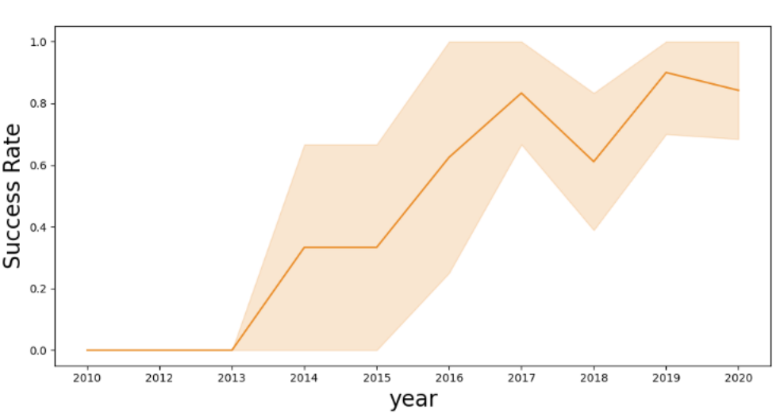
Launch Success Yearly Trend
Success rate has increased as time has passed
There was a dip in success rate from 2017-2018 and 2019-2020

Slide 22
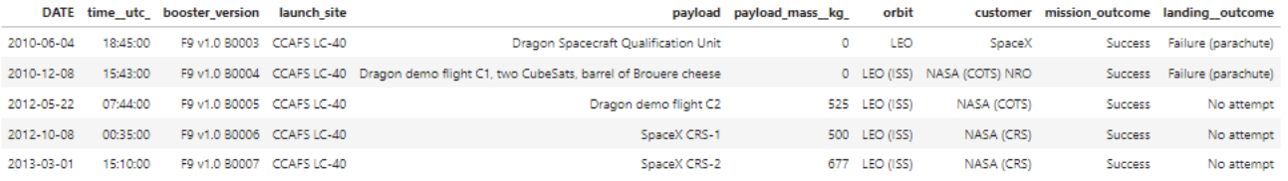
Launch Sites
Our 4 launch sites were:
CCAFS LC-40
CCAFS SLC-40
KSC LC-39A
VAFB SLC-4E
5 Records with Launch Sites starting with “CCA”

Slide 23
Payload Mass
In total, 45,596 kg of payload mass were carried by boosters launched by NASA (CRS)
The average payload carried by a booster version F9 v1.1 was 2,928 kg.

Slide 24
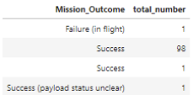
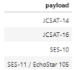
First Successful Ground Landing Date
The first successful landing in Ground Pad was on 12/22/2015
In total, 99 successes and 1 failure in flight
The following boosters had payloads between 4,000 and 6,000 kg and were successful

Slide 25
Boosters Carried Maximum Payload
The following boosters were able to carry the max payload:
F9 B5 B1048.4
F9 B5 B1049.4
F9 B5 B1051.3
F9 B5 B1056.4
F9 B5 B1048.5
F9 B5 B1051.4
F9 B5 B1049.5
F9 B5 B1060.2
F9 B5 B1058.3
F9 B5 B1051.6
F9 B5 B1060.3
F9 B5 B1049.7

Slide 26
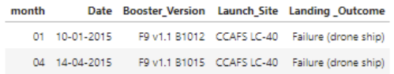
2015 Launch Records
Listed the failed landing outcomes in drone ship, their booster versions, and launch site names for in year 2015

Slide 27
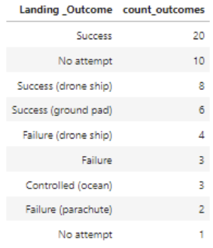
Rank Landing Outcomes Between 2010-06-04 and 2017-03-20
Ranked the count of landing outcomes (such as Failure (drone ship) or Success (ground pad)) between the date 2010-06-04 and 2017-03-20, in descending order

Slide 28

Section 3

Slide 29
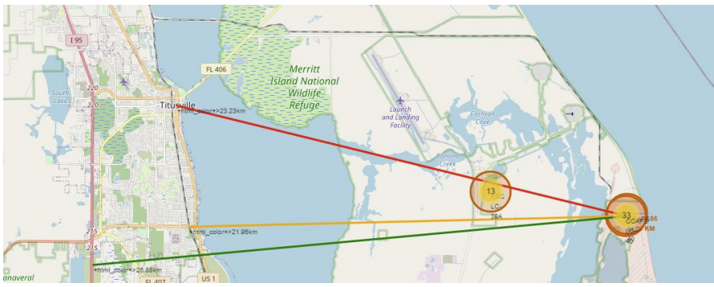
Distance to Proximities
CCAFS SLC-40
0.86 km from nearest coastline
21.96km from nearest railway
23.23km from nearest city
26.88 km from nearest highway
By keeping the launch site near the coast, it ensures any nothing falls on people or property. The median distance from railways, cities, and highways allows it to be close enough to receive supplies and materials while also being far enough to keep unauthorized people away and stay safe.

Slide 30
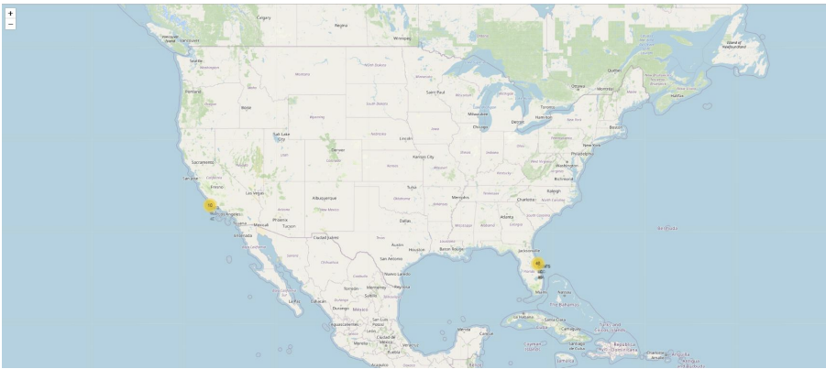
Launch site
The launch sites are near the equator, this makes it easier to launch as the Earth’s rotation is greater and aids in launch the rocket. This helps cut costs by reducing the amount of fuel and boosters needed.

Slide 31

Section 4

Slide 32
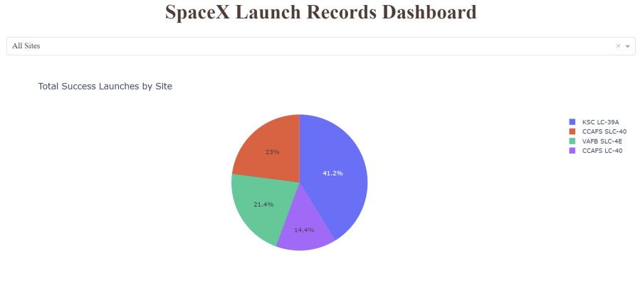
Launch Site Success Rates
KSC LC-39A has the highest success rate between the launch sites
CCAFS LC-40 has the lowest success rate between the launch sites

Slide 33
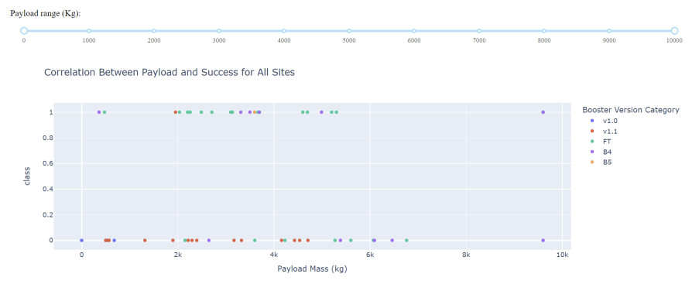
Payload Mass and Success
Payloads between 2,000 and 5,000 kg had the highest success rates
0 is unsuccessful, 1 is successful

Slide 34

Section 5

Slide 35
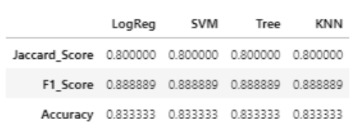
Classification Accuracy
All the models performed similarly to each other, having the same scores and accuracy.
The Decision tree did a little better than the other models when looking at the .best_score_

Slide 36
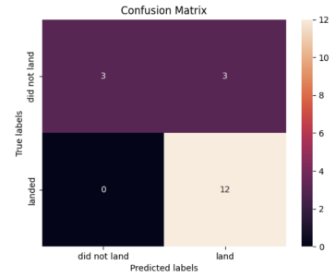
Confusion Matrix
Confusion matrix outputs
12 True positives
3 False positives
3 True negatives
0 false negatives
Precision: .8
Recall: 1
F1 Score: .89
Accuracy: .833

Slide 37
Conclusions
Launch Success Trends: Launch success rates have generally improved over time, with KSC LC 39A and CCAFS SLC 40 showing the highest success rates, particularly for payloads in the range of up to 10,000 kg and above.
Influence of Payload and Orbit: Heavier payloads, especially those above 6,000 kg, and orbits such as LEO (Low Earth Orbit) and GEO (Geostationary Earth Orbit) have a higher success rate. These orbits are more likely to be reached successfully when launched from CCAFS SLC 40 or KSC LC 39A.
Predictive Model Performance: Among the models tested (logistic regression, SVM, decision tree, K-nearest neighbors), the decision tree model slightly outperformed the others in predicting landing success, with higher accuracy on the test set.
Geographic Considerations: Launch sites near the equator, such as CCAFS SLC 40 and KSC LC 39A, benefit from additional rotational velocity, aiding in fuel efficiency and reducing costs. This proximity to the equator and coastlines contributes to higher launch success and safety.

Slide 38


